Slide 1
HOA ASSESSMENTS UPDATE
April 4, 2023
PRESENTED BY
Scott & Alice Ford

Slide 2
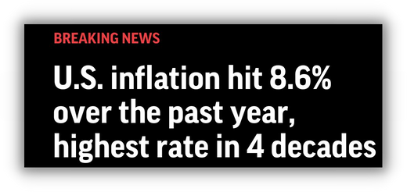
PRESENTATION OVERVIEW
DRE's Latest Requirements for HOA Budgeting
Basis for increases
Change in DRE Policy
How requirements are being instituted
Biggest price
spike in decades
Impacts to YOU
New projects
Existing projects
Phasing program considerations

Slide 3
LATEST ANNOUNCEMENTS FROM DRE
All budgets, effective immediately...
Must inflate all DRE Required costs by 25%
Must increase utilities based on future increases
Must obtain TWO written quotes or contracts for services
Must provide historical operating costs (aged/existing projects)

Slide 4
LATEST ANNOUNCEMENTS FROM DRE
Previously Approved budgets need updating if….
ANY delay of completion of common area
20%
ANY change to the common area amenities
10%
ANY change to the phasing schedule
ANY increase/decrease in lot/unit count
ANY increase/decrease from approved budget
ANY change in subsidy or maintenance agreements
ALL budgets after 24 months

Slide 5
The budget went up…
What Happens when the RANGE changes in a Range of Assessments?
If your new Range Budget is higher (or lower) than the last approved Range, you need to submit a new budget package for approval.
This voids ALL Public Reports issued.
Potential BLACKOUT period for filing Renewals with Assessment increases...
The DRE will not issue new public reports while a budget review is in process, even if the old budget is still valid.
To resubmit: Current budget, new budget, financial statements, bank statement, reserve study, HOA minutes, delinquency reports, & all new bids for future phases.

Slide 6
The budget went up…
What happens when the phase budgets increase?
You can raise a traditional/phased budget by 19% and still be deemed valid by DRE.
If the budget goes 20% above the approved amount, it’s invalid.
This voids ALL Public Reports issued.
Potential BLACKOUT period for filing Renewals with Assessment increases...
The DRE will not issue new public reports while a budget review is in process, even if the old budget is still valid.
To resubmit: Current budget, new budget, financial statements, bank statement, reserve study, HOA minutes, delinquency reports, & all new bids for future phases.

Slide 7
RESERVE COST INCREASES - EXISTING & NEW PROJECTS
Existing & On-Going Projects:
The developer must leave HOA with 100% funded reserves (Ravens Cove)
The developer must update the budget annually or with each new phase.
The developer must ensure proper accounting of funds and board meeting minutes made available.
The developer must ensure no related entities are contracted with the HOA. (3rd parties only)

Slide 8
What Can YOU do?
Stay on the Board – We know you hate it, but you need to.
Release of information to non-board members
Not accepting new phase budgets
Extending costs
Manage your Manager – make sure they spend within budget.
Xmas Decorations
Water leaks
Budget Preparer needs to do the Reserve Study – (shameless plug, but it’s true)
Unannexed common area
Missing DRE required info
Map Phase vs. Development Phase vs. Marketing Phase
Prepare 6 months ahead of any changes – be ready to submit when the budget changes!

Slide 9
OPTIONS TO CONSIDER
Utilize Cost Centers as opposed to Sub HOA’s
"Non-CID" Developments
"Structurally Independent" Townhomes
Eliminate Attached DU's – “Do the DuPlex”
Omit Cantilevered Balconies
More Long-Lasting Building Components

Slide 10
Thank You!
Questions?
Scott Ford
scott@cabuilderservices.com
Alice Ford
alice@cabuilderservices.com

